Slide 1
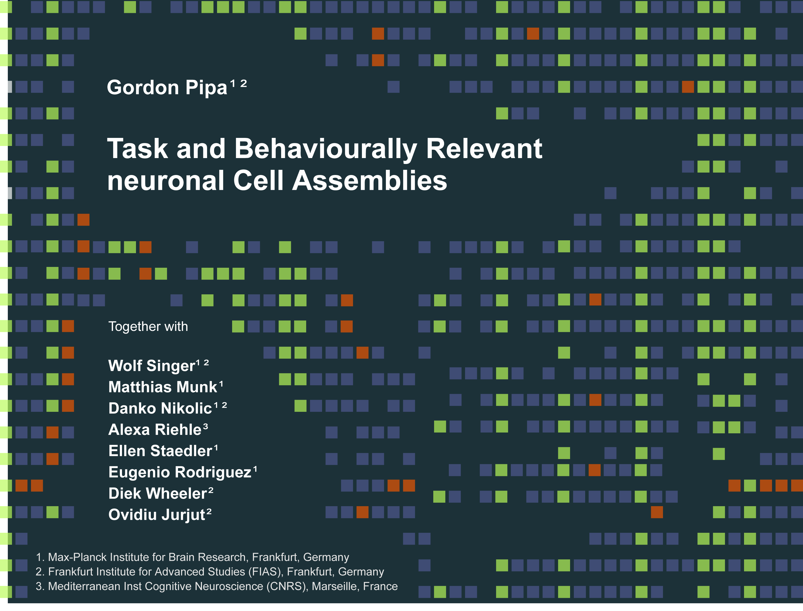
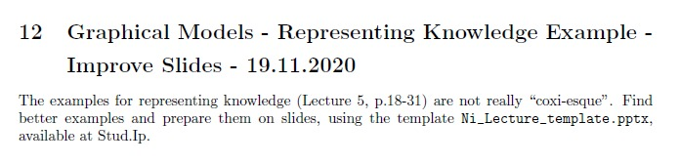
Neuroinformatics Lecture (L5)
Improve Slides
Group 30:
Fabian Imkenberg,
Jacqueline Näther,
Christoph Werries
Prof. Dr. Gordon Pipa
Institute of Cognitive Science, University of Osnabrück
Notes:
Hallo and thank you for the introduction.
I will present a non-parametric significance test for estimating the statistical significance of Joint-Spike events.

Slide 2

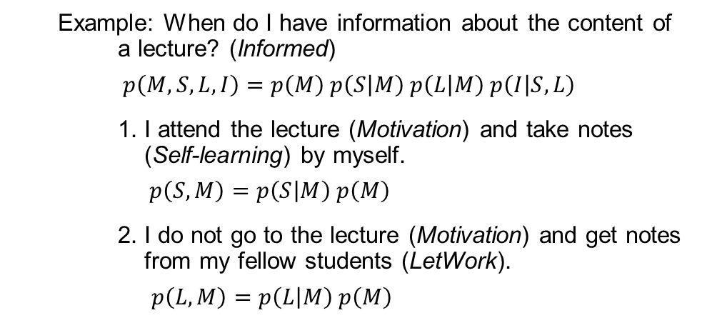



Representing knowledge example
How to use graphical models for real world problems?
The model can help us to understand how a special state is dependent on its conditions.
Example: When do I have information about the content of
a lecture? (Informed)
$p\left(M, S, L, I\right)=p\left(M\right) p\left(S | M\right) p\left(L | M\right) p\left(I | S,L\right)$
1. I attend the lecture (Motivation) and take notes (Self-learning) by myself.
$p\left(S,M\right)=p\left(S | M\right) p\left(M\right)$
2. I do not go to the lecture (Motivation) and get notes from my fellow students (LetWork).
$p\left(L,M\right)=p\left(L | M\right) p\left(M\right)$
$$p(M)$$
Motivation
$$p(S, M)$$
$$p(L, M)$$
Self-learning
LetWork
Informed
$$p(M, S, L,I)$$
Knowing the probabilities, there is a way to easily represent the topology of the network with concrete probability values.
➔ Conditional Probability Tables (CPT)

Slide 3
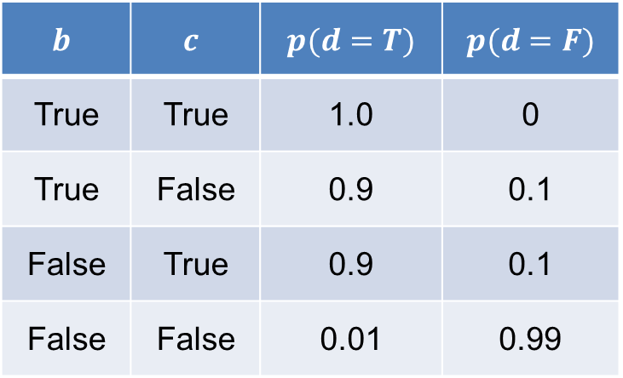




Representing knowledge example
$$p(a)$$
How do CPTs work?
a
Conditions of the parent nodes for the considered node.
$$p(a,b)$$
$$p(a,c)$$
b
c
Probabilities of each case for the considered node.
d
$$p(a,b,c,d)$$
$$b$$ | $$c$$ | $$p(d=T)$$ | $$p(d=F)$$
True | True | 1.0 | 0
True | False | 0.9 | 0.1
False | True | 0.9 | 0.1
False | False | 0.01 | 0.99
Probabilities of the considered node (here d).
The probabilities of each conditional case must sum up to 1.
Conditional cases of the parent nodes for the considered node.

Slide 4
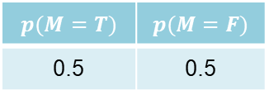
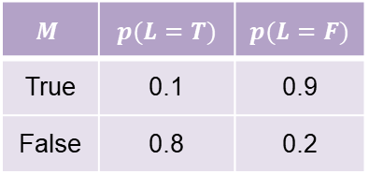



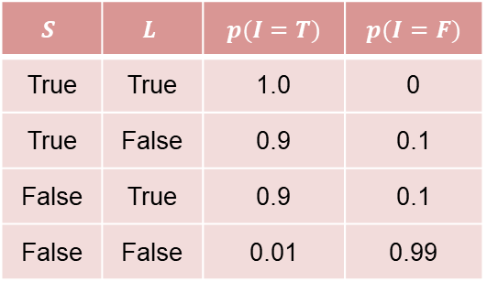

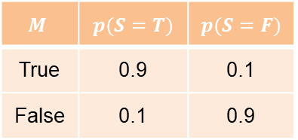
Representing knowledge example
Example: Using CPTs for real world problems.
$$p(M=T)$$ | $$p(M=F)$$
0.5 | 0.5
$$p(M)$$
Motivation
$$M$$ | $$p(S=T)$$ | $$p(S=F)$$
True | 0.9 | 0.1
False | 0.1 | 0.9
$$p(S,M)$$
$$p(L, M)$$
$$M$$ | $$p(L=T)$$ | $$p(L=F)$$
True | 0.1 | 0.9
False | 0.8 | 0.2
Self-learning
LetWork
Informed
$$p(M,S,L,I)$$
$$S$$ | $$L$$ | $$p(I=T)$$ | $$p(I=F)$$
True | True | 1.0 | 0
True | False | 0.9 | 0.1
False | True | 0.9 | 0.1
False | False | 0.01 | 0.99

Slide 5

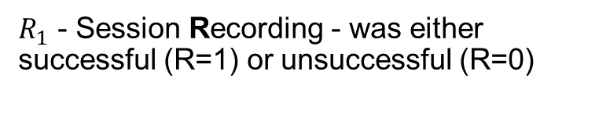
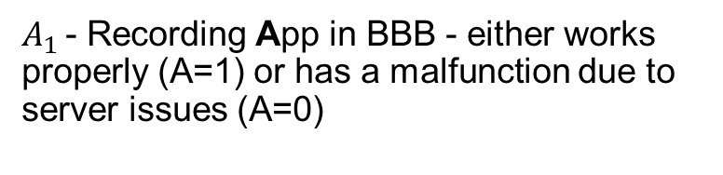
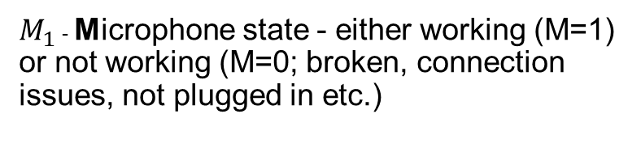
Representing knowledge: BBB example
It is worth spending a moment to understand further the possible surprising behaviour of the graph. Consider a particular instance of such a graph corresponding to a problem with three binary random variables related to a working lecture recording using BigBlueButton.
The variables are called:
$M_{1}$ - Microphone state - either working (M=1) or not working (M=0; broken, connection issues, not plugged in etc.)
M
A
$A_{1}$ - Recording App in BBB - either works properly (A=1) or has a malfunction due to server issues (A=0)
R
$R_{1}$ - Session Recording - was either successful (R=1) or unsuccessful (R=0)

Slide 6
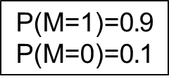
Representing knowledge: BBB example
$$\text{P}\text{(}\text{M}\text{=}\text{1}\text{)=}\text{0}.\text{9}$$
$$\text{P}\text{(}\text{M}\text{=}\text{0}\text{)=}\text{0}.\text{1}$$
P(A=1)=0.9
P(A=0)=0.1
M
A
P(A=1) | P(A=0)
0.9 | 0.1
P(M=1) | P(M=0)
0.9 | 0.1
R
M | A | P(R=1) | P(R=0)
0 | 0 | 0.1 | 0.9
1 | 0 | 0.2 | 0.8
0 | 1 | 0.2 | 0.8
1 | 1 | 0.8 | 0.2
P(R=1|M=1,A=1)=0.8
P(R=1|M=1,A=0)=0.2
P(R=1|M=0,A=1)=0.2
P(R=1|M=0,A=0)=0.1
P(R=0|M=1,A=1)=0.2
P(R=0|M=1,A=0)=0.8
P(R=0|M=0,A=1)=0.8
P(R=0|M=0,A=0)=0.9

Slide 7

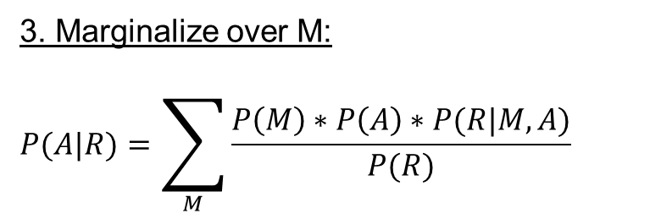
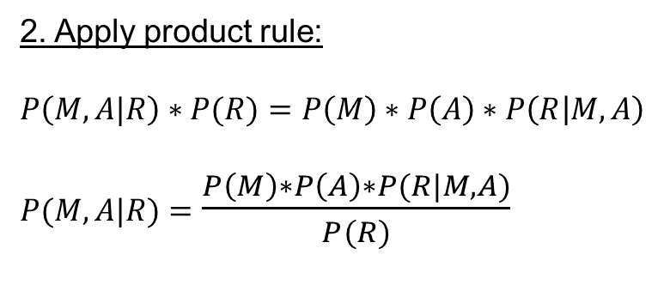
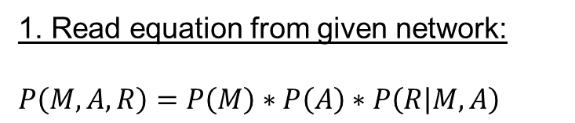
Representing knowledge: Calculation approach
Let’s assume we know that the recording does not work. The correct mathematical expression then would be:
M
A
$$P\left(A | R\right)= ?$$
1. Read equation from given network:
$$P\left(M,A,R\right)=P\left(M\right)∗P\left(A\right)∗P\left(R | M,A\right)$$
=
R
2. Apply product rule:
$$P\left(M,A|R\right)∗P(R)=P\left(M\right)∗P\left(A\right)∗P\left(R | M,A\right)$$
$P(M,A|R)$ $=$ $\frac{P\left(M\right)∗P\left(A\right)∗P(R|M,A)}{P(R)}$
As you can see in the tables on the previous slide, there is no P(R) that we could use since it is not directly given (depending on p(M) and p(A)).
So we have to calculate it somehow from the given information.
3. Marginalize over M:
$$P(A|R)=\sum_{M}{\frac{P\left(M\right)∗P\left(A\right)∗P(R|M,A)}{P(R)}}$$

Slide 8
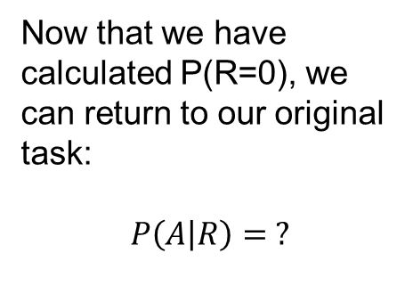
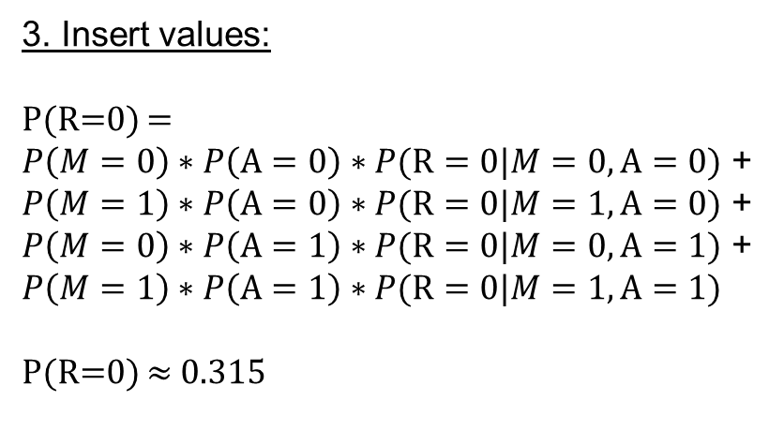
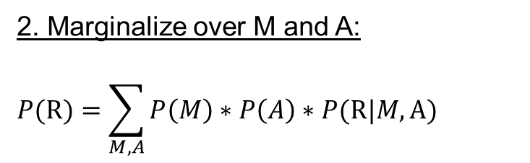
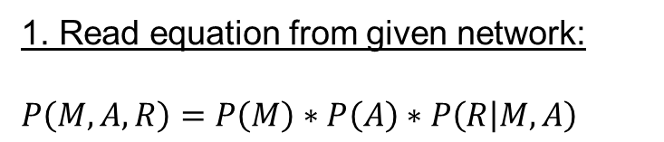

Representing knowledge: Calculation approach
$$P\left(R\right)= ?$$
1. Read equation from given network:
$$P\left(M,A,R\right)=P\left(M\right)∗P\left(A\right)∗P\left(R | M,A\right)$$
M
A
=
2. Marginalize over M and A:
$$P(R)=\sum_{M,A}{P\left(M\right)∗P\left(A\right)∗P(R|M,A)}$$
R
3. Insert values:
P(R=0) = $P\left(M=0\right)∗P\left(A=0\right)∗P(R=0|M=0,A=0)$ + $P\left(M=1\right)∗P\left(A=0\right)∗P(R=0|M=1,A=0)$ + $P\left(M=0\right)∗P\left(A=1\right)∗P(R=0|M=0,A=1)$ + $$P\left(M=1\right)∗P\left(A=1\right)∗P(R=0|M=1,A=1)$$
P(R=0) $≈$ 0.315
Now that we have calculated P(R=0), we can return to our original task:
$$P\left(A | R\right)= ?$$

Slide 9
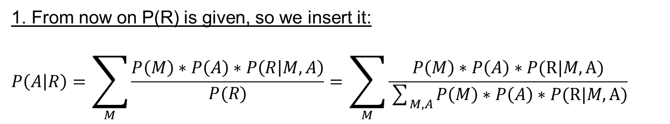
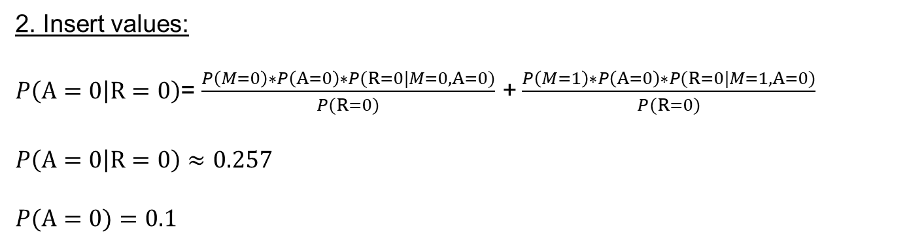
Representing knowledge: Calculation approach
1. From now on P(R) is given, so we insert it:
$$P\left(A | R\right)=\sum_{M}{\frac{P\left(M\right)∗P\left(A\right)∗P\left(R | M,A\right)}{P(R)}}=\sum_{M}{\frac{P\left(M\right)∗P\left(A\right)∗P(R|M,A)}{\sum_{M,A}{P\left(M\right)∗P\left(A\right)∗P(R|M,A)}}}$$
2. Insert values:
$P\left(A=0 | R=0\right)$= $\frac{P\left(M=0\right)∗P\left(A=0\right)∗P(R=0|M=0,A=0)}{P(R=0)}$ +$\frac{P\left(M=1\right)∗P\left(A=0\right)∗P(R=0|M=1,A=0)}{P(R=0)}$
$P\left(A=0 | R=0\right)$ $≈$ $0.257$
$$P(A=0)=0.1$$
The probability of problems with the recording app (A) increases with the observation of R = 0.
P(A = 0|R = 0) > P(A = 0)
Thus, knowing that the recording was not successful, it is more likely that the recording app did not work properly. - Common sense expressed mathematically.

Slide 10
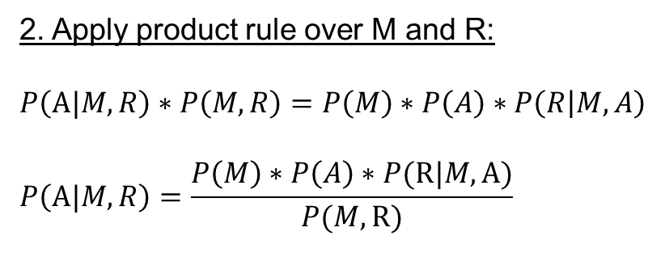
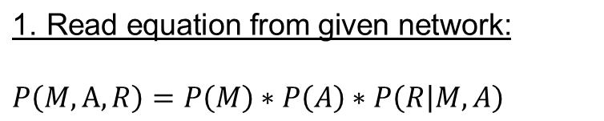

Representing knowledge: Explaining away
Let’s assume we know that the recording app is not working, the microphone is broken as well and we would still like to know the probability that the recording app is responsible for a failed recording. The correct mathematical expression then would be:
M
A
=
R
$P(A|R,M)$ = ?
$$\text{1. }\text{Read} \text{equation} \text{from} \text{given} \text{network}\text{:}$$
$$P\left(M,A,R\right)=P\left(M\right)∗P\left(A\right)∗P\left(R | M,A\right)$$
As you can see in the tables on the previous slide, there is no P(M,R) that we could use since it is not directly given (dependent on p(M) and p(A)).
So we have to calculate it somehow from the given information.
2. Apply product rule over M and R:
$$P\left(A|M,R\right)∗P\left(M,R\right)=P\left(M\right)∗P\left(A\right)∗P\left(R | M,A\right)$$
$$P\left(A|M,R\right)=\frac{P\left(M\right)∗P\left(A\right)∗P(R|M,A)}{P(M,R)}$$

Slide 11

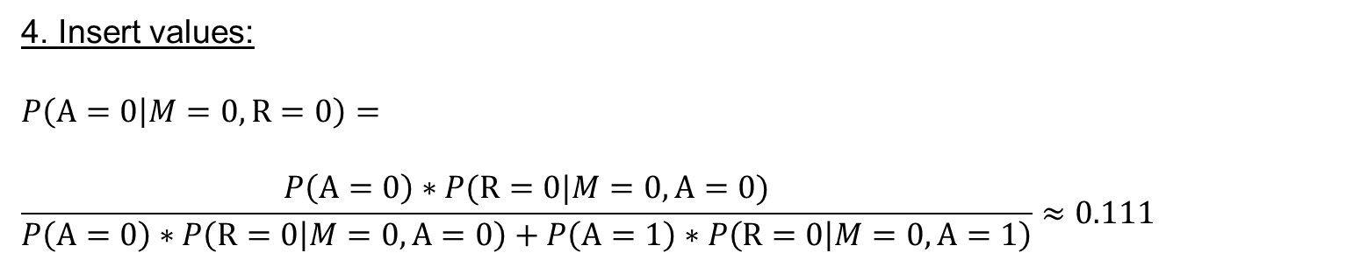
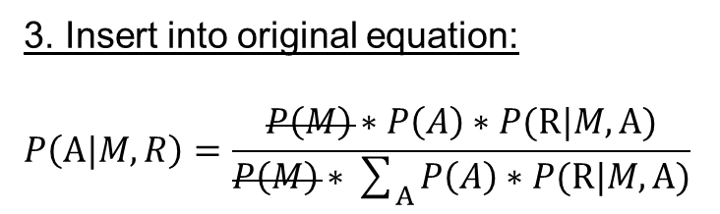
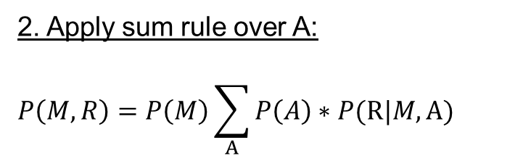
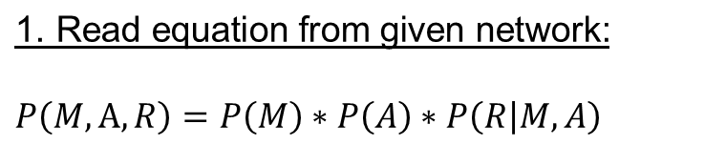
Representing knowledge: Explaining away
$$P\left(M,R\right)= ?$$
$$\text{1}\text{. }\text{Read} \text{equation} \text{from} \text{given} \text{network}\text{:}$$
$$P\left(M,A,R\right)=P\left(M\right)∗P\left(A\right)∗P\left(R | M,A\right)$$
M
A
=
2. Apply sum rule over A:
$$P\left(M,R\right)=P\left(M\right)\sum_{A}{P\left(A\right)∗P(R|M,A)}$$
R
The probability of a malfunction in BBB (A=0) is reduced due to observing the malfunction of the microphone (M=0).
Finding out that the microphone is not working explains that the recording was not successful and thus explains away a malfunction in BBB.
3. Insert into original equation:
$$P\left(A|M,R\right)=\frac{P\left(M\right)∗P\left(A\right)∗P(R|M,A)}{P\left(M\right)∗\sum_{A}{P\left(A\right)∗P(R|M,A)}}$$
4. Insert values:
$$P\left(A=0 | M=0,R=0\right)=$$
$$\frac{P\left(A=0\right)∗P(R=0|M=0,A=0)}{P\left(A=0\right)∗P\left(R=0 | M=0,A=0\right)+P\left(A=1\right)∗P\left(R=0 | M=0,A=1\right)}≈0.111$$

Slide 12
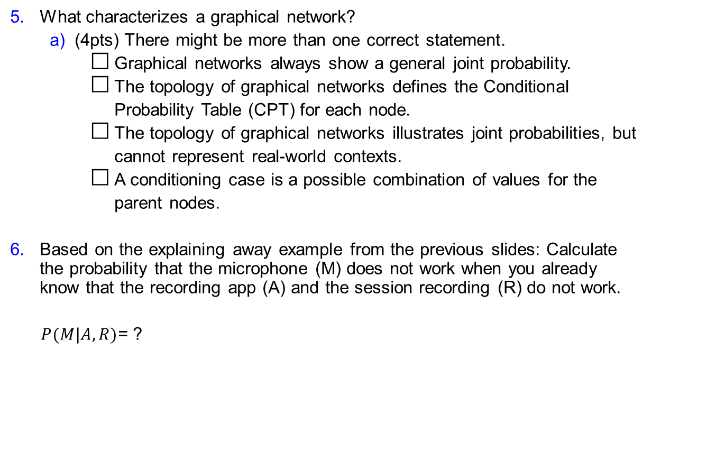
Questionnaire – Q3 – Problem 5+6
Q
What characterizes a graphical network?
(4pts) There might be more than one correct statement.
Graphical networks always show a general joint probability.
The topology of graphical networks defines the Conditional
Probability Table (CPT) for each node.
The topology of graphical networks illustrates joint probabilities, but
cannot represent real-world contexts.
A conditioning case is a possible combination of values for the
parent nodes.
Based on the explaining away example from the previous slides: Calculate the probability that the microphone (M) does not work when you already know that the recording app (A) and the session recording (R) do not work.
$P(M|A,R)$= ?
Start
Timer
M
A
R
Stop

Slide 13
Questionnaire – Q3 – Problem 5+6
S
What characterizes a graphical network?
(4pts) There might be more than one correct statement.
Graphical networks always show a general joint probability.
The topology of graphical networks defines the Conditional
Probability Table (CPT) for each node.
The topology of graphical networks illustrates joint probabilities, but
cannot represent real-world contexts.
A conditioning case is a possible combination of values for the
parent nodes.

Slide 14
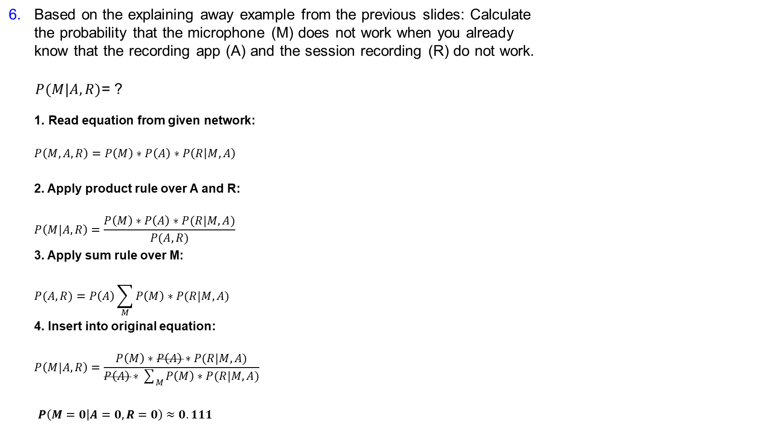
Questionnaire – Q3 – Problem 5+6
S
Based on the explaining away example from the previous slides: Calculate the probability that the microphone (M) does not work when you already know that the recording app (A) and the session recording (R) do not work.
$P(M|A,R)$= ?
$$\text{1}\text{. }\text{Read} \text{e}\text{quation} \text{from} \text{given} \text{network}\text{:}$$
$$P\left(M,A,R\right)=P\left(M\right)∗P\left(A\right)∗P\left(R | M,A\right)$$
2. Apply product rule over A and R:
$$P\left(M|A,R\right)=\frac{P\left(M\right)∗P\left(A\right)∗P(R|M,A)}{P(A,R)}$$
3. Apply sum rule over M:
$$P(A,R)=P\left(A\right)\sum_{M}{P\left(M\right)∗P(R|M,A)}$$
4. Insert into original equation:
$$P\left(M|A,R\right)=\frac{P\left(M\right)∗P\left(A\right)∗P(R|M,A)}{P\left(A\right)∗\sum_{M}{P\left(M\right)∗P(R|M,A)}}$$
$P\left(M=0 | A=0,R=0\right)$ $≈0.111$
M
A
R

Slide 15
MIT License
Copyright (c) [2020] [Fabian Imkenberg, Jacqueline Näther, Christoph Werries]
Permission is hereby granted, free of charge, to any person obtaining a copy
of this software and associated documentation files (the "Software"), to deal
in the Software without restriction, including without limitation the rights
to use, copy, modify, merge, publish, distribute, sublicense, and/or sell
copies of the Software, and to permit persons to whom the Software is
furnished to do so, subject to the following conditions:
The above copyright notice and this permission notice shall be included in all
copies or substantial portions of the Software.
THE SOFTWARE IS PROVIDED "AS IS", WITHOUT WARRANTY OF ANY KIND, EXPRESS OR
IMPLIED, INCLUDING BUT NOT LIMITED TO THE WARRANTIES OF MERCHANTABILITY,
FITNESS FOR A PARTICULAR PURPOSE AND NONINFRINGEMENT. IN NO EVENT SHALL THE
AUTHORS OR COPYRIGHT HOLDERS BE LIABLE FOR ANY CLAIM, DAMAGES OR OTHER
LIABILITY, WHETHER IN AN ACTION OF CONTRACT, TORT OR OTHERWISE, ARISING FROM,
OUT OF OR IN CONNECTION WITH THE SOFTWARE OR THE USE OR OTHER DEALINGS IN THE
SOFTWARE.

